Slide 1
Day 5 - The Web, Computational Infrastructure, and Innovative Datasets
UMN CSS Workshop 2025
Instructor: Alvin Zhou

Slide 2
Group
Group 1
Gretchen Corcoran
Jikai Sun
Shreepriya Dogra
Jialu Fan
Group 2
Jiacheng Huang
Paulina Vergara Buitrago
Jong Won Lee
Eun Sun Kyoung
Group 3
Sijin Chen
Michael Ofori
Jinny Zhang
Dongwook Kim
Group 4
Raj Wahlquist
Nicole Marie Klevanskaya
Wenhui Cheng
Rita Rongwei Tang
Mixed background and coding skills
Group members who are confident in their coding skills, please help other members during the afternoon coding labs

Slide 3
Learning Goals
Understand behavioral trace data
Overview of prior-decade data collection methods (API)
Post-API era: Scraping, data donation, collaboration, audit, etc.
Discuss data ethics

Slide 4
A Paradigm Shift in Social Science
From surveys and self-reports → behavioral traces and digital exhaust
Surveys: What people say they do
Traces: What people actually do
Both are biased, but differently
Key advantage: Less filtered, less recall bias
Key risk: Less context, harder to interpret meaningfully

Slide 5
Behavioral Trace Data: Beyond Social Media
First of all, we should not equate behavioral trace to online behavioral trace or online social media behavioral trace
Online social media activity ≠ entire digital life ≠ entire life
Browsing logs
Search histories
Location & mobility data (e.g., Google Maps)
Environmental imagery (e.g., Street View, satellite)
Wearables, app logs, e-commerce trails

Slide 6
Gebru et al. (2017): Google Street View
RQ: Can we infer socioeconomic patterns from the environment people live in?
Analyzed 50 million Google Street View images across 200 U.S. cities.
Used deep learning to identify 22 million vehicles by make, model, and year.
Found strong correlations between vehicle types and:
Income levels
Educational attainment
Racial composition
Voting patterns:
More sedans → likely Democratic; More pickups → likely Republican

Slide 7
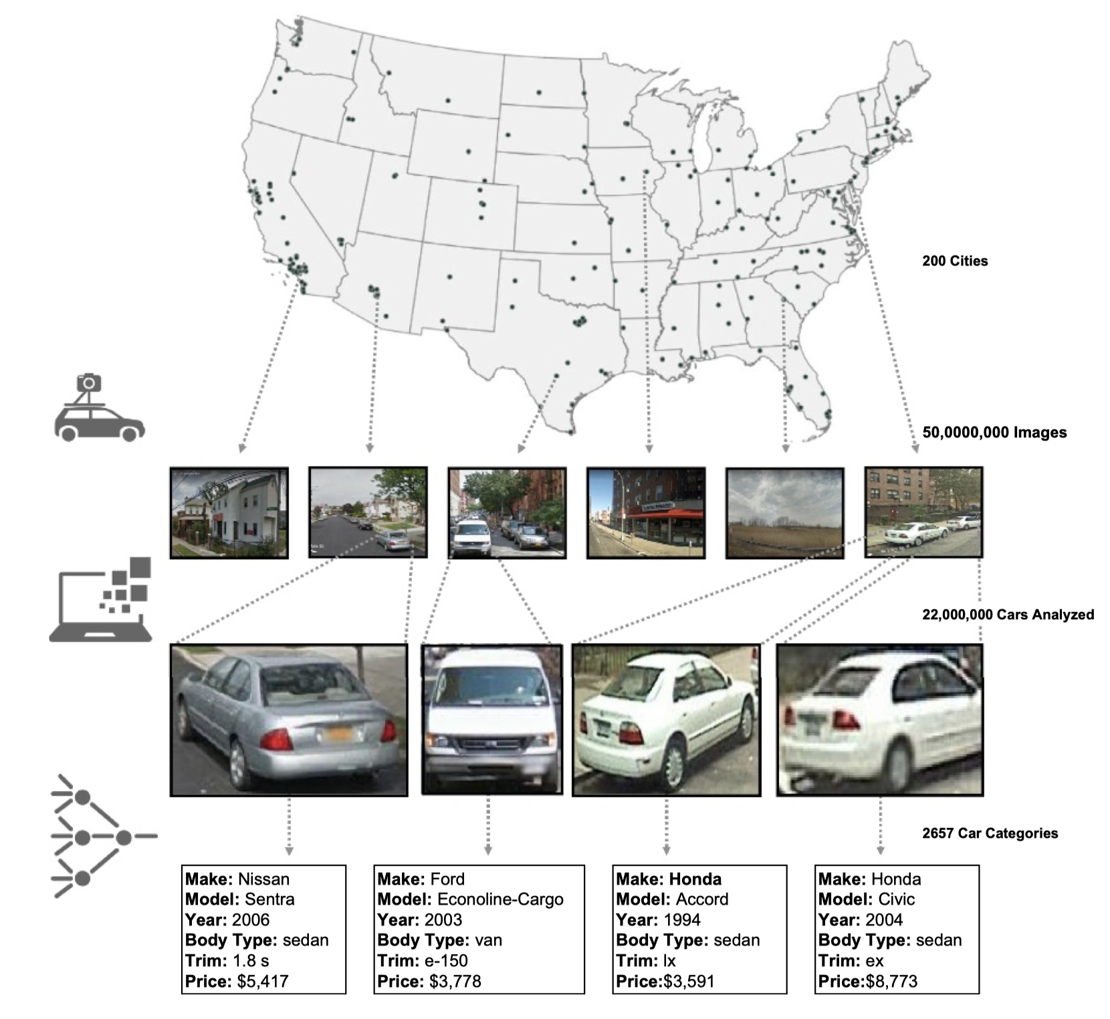
Notes:
Fig. 1. We perform a vehicular census of 200 cities in the United States using 50 million Google Street View images. In each image, we detect cars with computer vision algorithms based on DPM and count an estimated 22 million cars. We then use CNN to categorize the detected vehicles into one of 2,657 classes of cars. For each type of car, we have metadata such as the make, model, year, body type, and price of the car in 2012. Images courtesy of Google Maps/Google Earth.

Slide 8
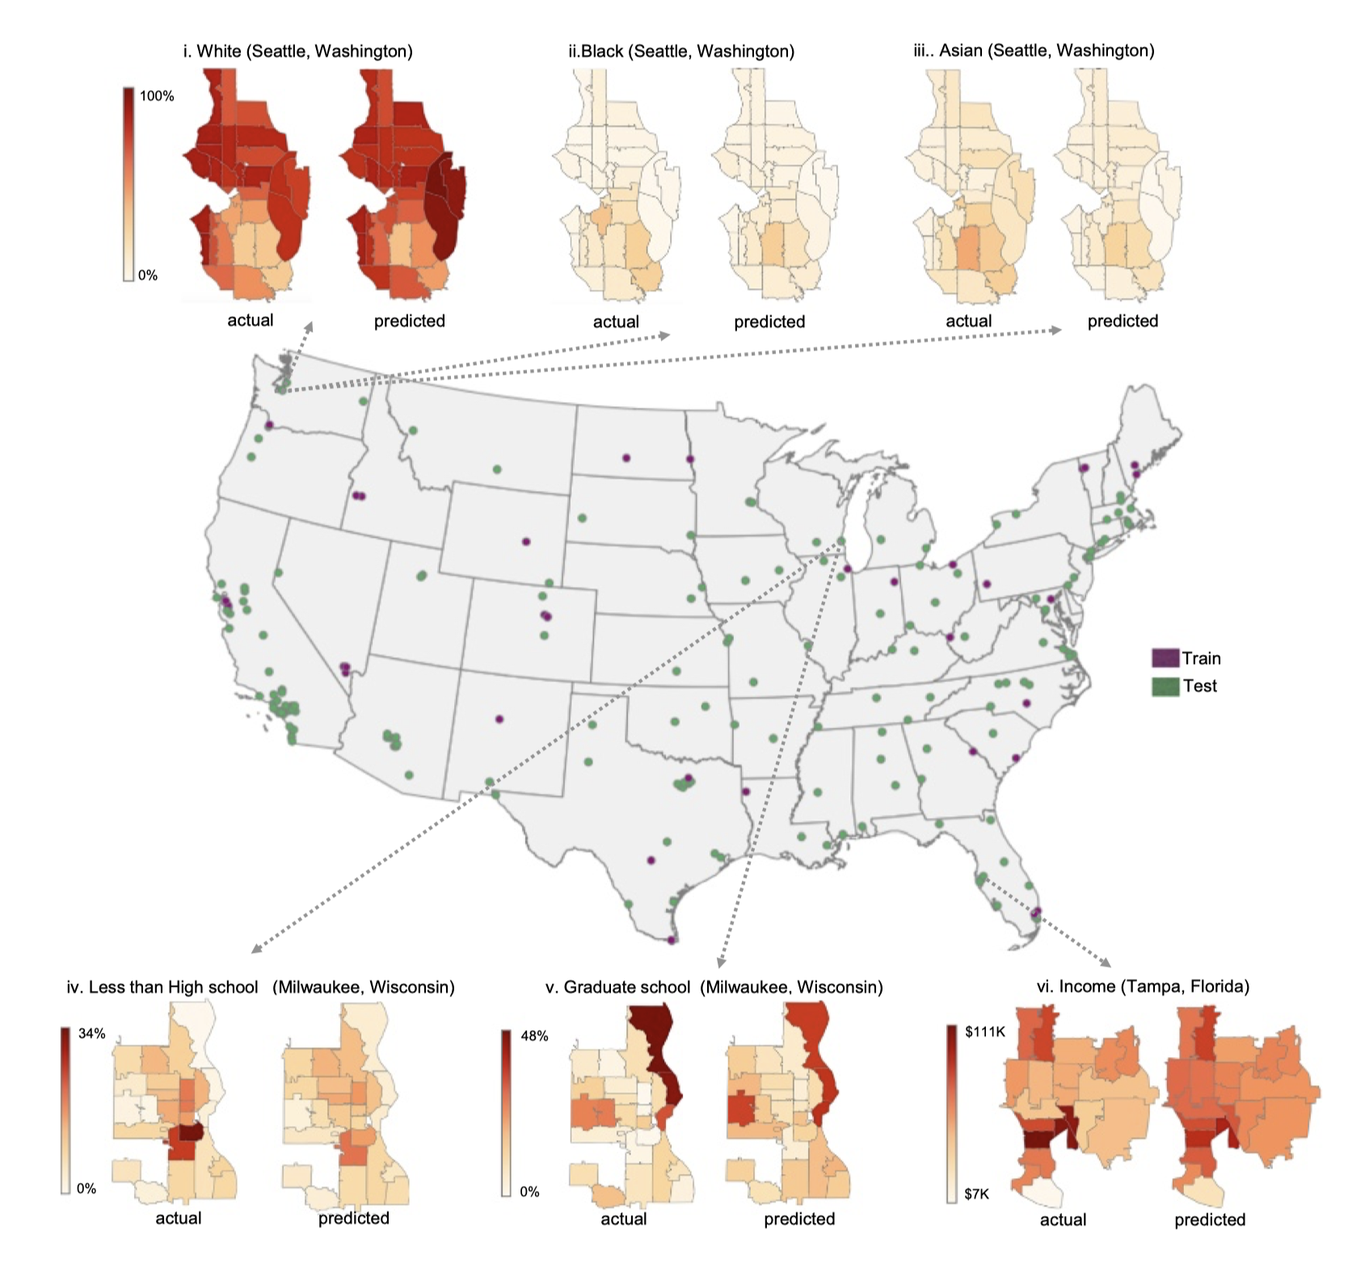
Notes:
Fig. 2. We use all of the cities in counties starting with A, B, and C (shown in purple on the map) to train a model estimating socioeconomic data from car attributes. Using this model, we estimate demographic variables at the zip code level for all of the cities shown in green. We show actual vs. predicted maps for the percentage of Black, Asian, and White people in Seattle, WA (i–iii); the percentage of people with less than a high school degree in Milwaukee, WI (iv); and the percentage of people with graduate degrees in Milwaukee, WI (v). (vi) Maps the median household income in Tampa, FL. The ground truth values are mapped on Left, and our estimated results are on Right. We accurately localize zip codes with the highest and lowest concentrations of each demographic variable such as the three zip codes in Eastern Seattle with high concentrations of Caucasians, one Northern zip code in Milwaukee with highly educated inhabitants, and the least wealthy zip code in Southern Tampa.

Slide 9
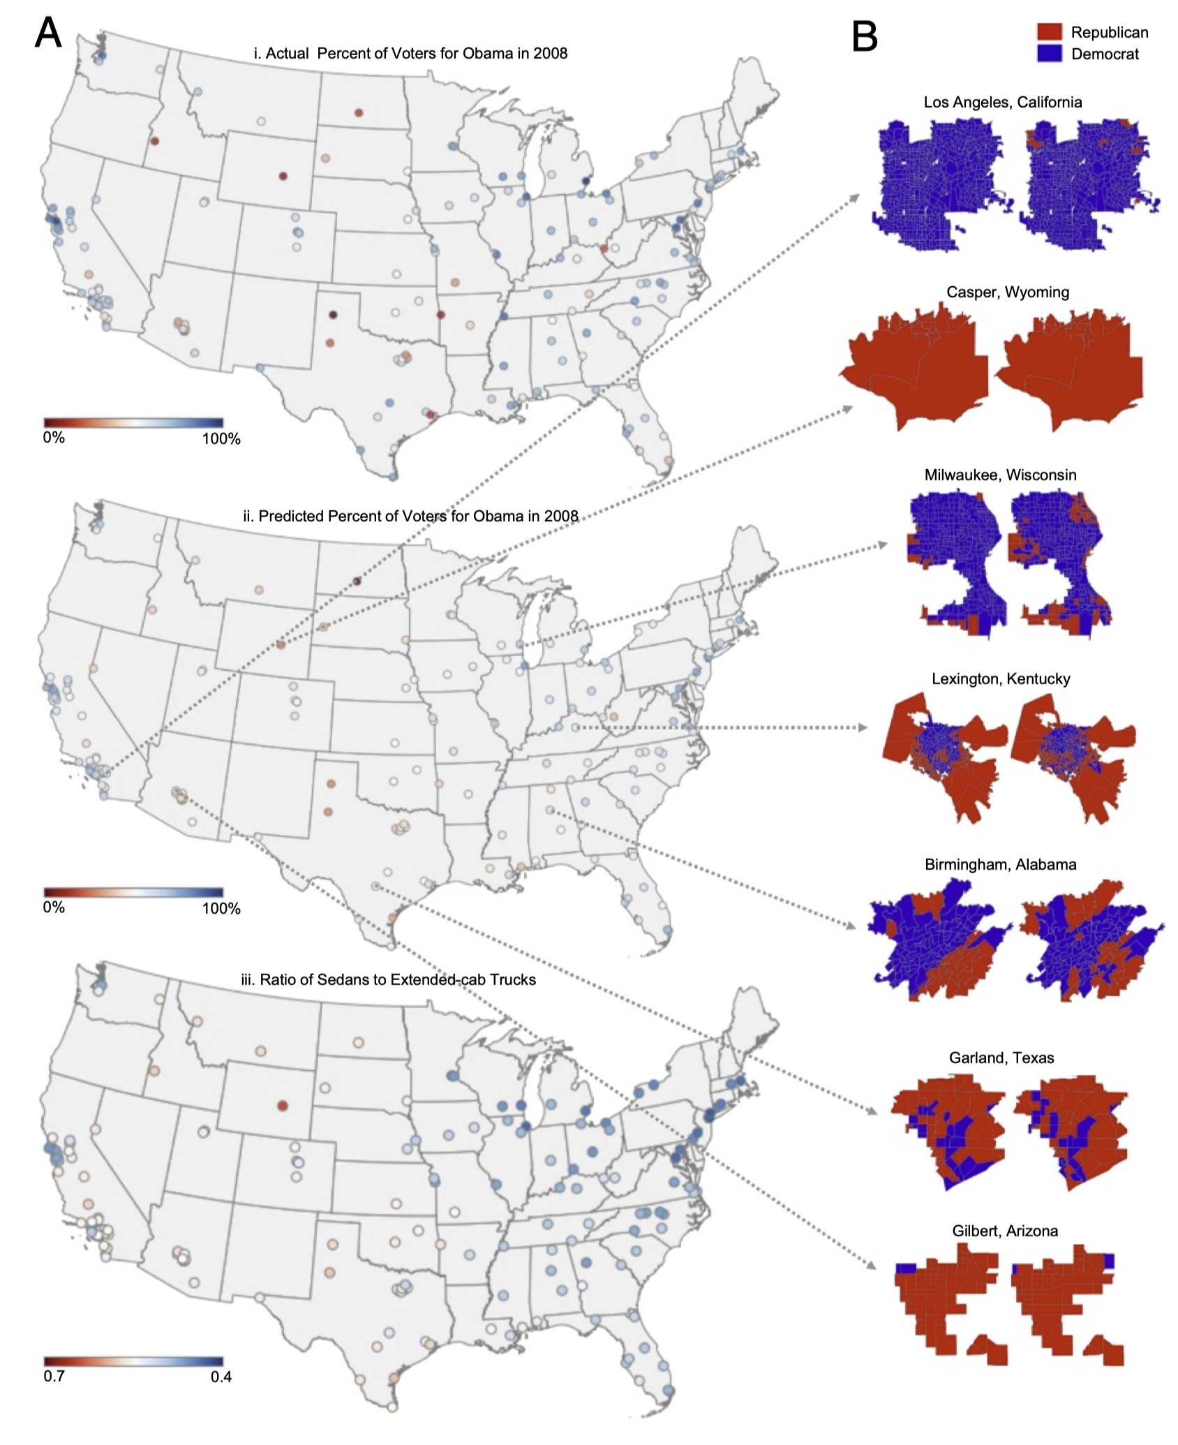
Notes:
Fig. 3. Actual and inferred voting patterns. A, i and ii map the actual and predicted percentage of people who voted for Barack Obama in the 2008 presidential election (r = 0.74). iii maps the ratio of detected pickup trucks to sedans in the 165 cities in our test set. As can be seen from the map, the ratio is very low in Democratic cities such as those in the East Coast and high in Republican cities such as those in Texas and Wyoming. (B) Shows actual vs. predicted voter afﬁliations for various cities in our test set at the precinct level using our full model. Democratic precincts are shown in blue, and Republican precincts are shown in red. Our model correctly classiﬁes Casper, WY as a Republican city and Los Angeles, CA as a Democratic city. We accurately predict that Milwaukee, WI is a Democratic city except for a few Republican precincts in the southern, western, and northeastern borders of the city.

Slide 10
Althoff et al. (2017): Fitness Tracking
Traditional social science relied on surveys, diaries, or lab studies to track health behavior.
Mobile apps and wearable tech (e.g., smartphones, Fitbit) enable real-time, passive, global data collection.
Collaboration with corporate platforms (e.g., Argus app) allows access to massive behavioral datasets.
68 million days of physical activity from 717,000 users across 111 countries.
Activity inequality as a stronger predictor of obesity.

Slide 11
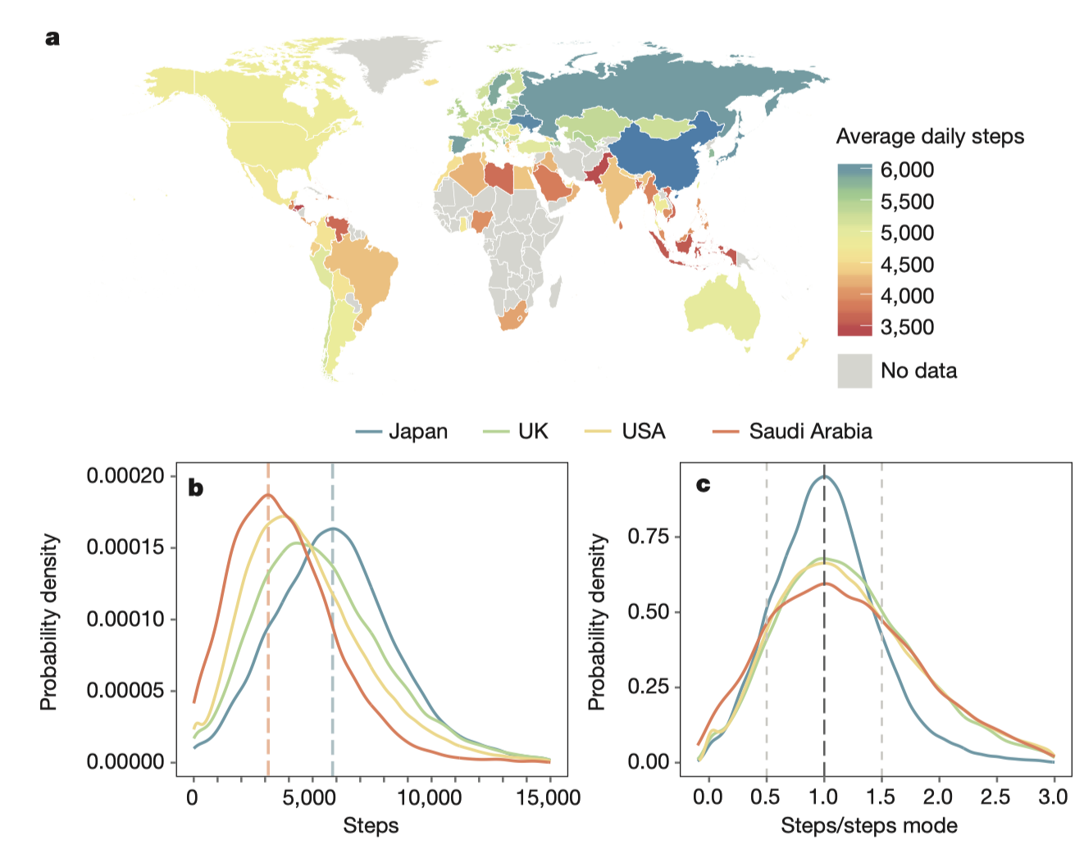
Notes:
Figure 1 | Smartphone data from over 68 million days of activity by 717,527 individuals reveal variability in physical activity across the world.
a, World map showing variation in activity (mean daily steps) between countries measured through smartphone data from 111 countries with at least 100 users. Cool colours correspond to high activity (for example, Japan in blue) and warm colours indicate low levels of activity (for example, Saudi Arabia in orange). b, Typical activity levels (distribution mode) differ between countries. Curves show distribution of steps across the population in four representative countries as a normalized probability density (high to low activity: Japan, UK, USA, Saudi Arabia). Vertical dashed lines indicate the mode of activity for Japan (blue) and Saudi Arabia (orange). c, The variance of activity around the population mode differs between countries. Curves show distribution of steps across the population relative to the population mode. In Japan, the activity of 76% of the population falls within 50% of the mode (that is, between the light grey dashed lines), whereas in Saudi Arabia this fraction is only 62%. The UK and USA lie between these two extremes for average activity level and variance. This map is based on CIA World Data Bank II data, publicly available through the R package mapdata (https://www.r-project.org/).

Slide 12
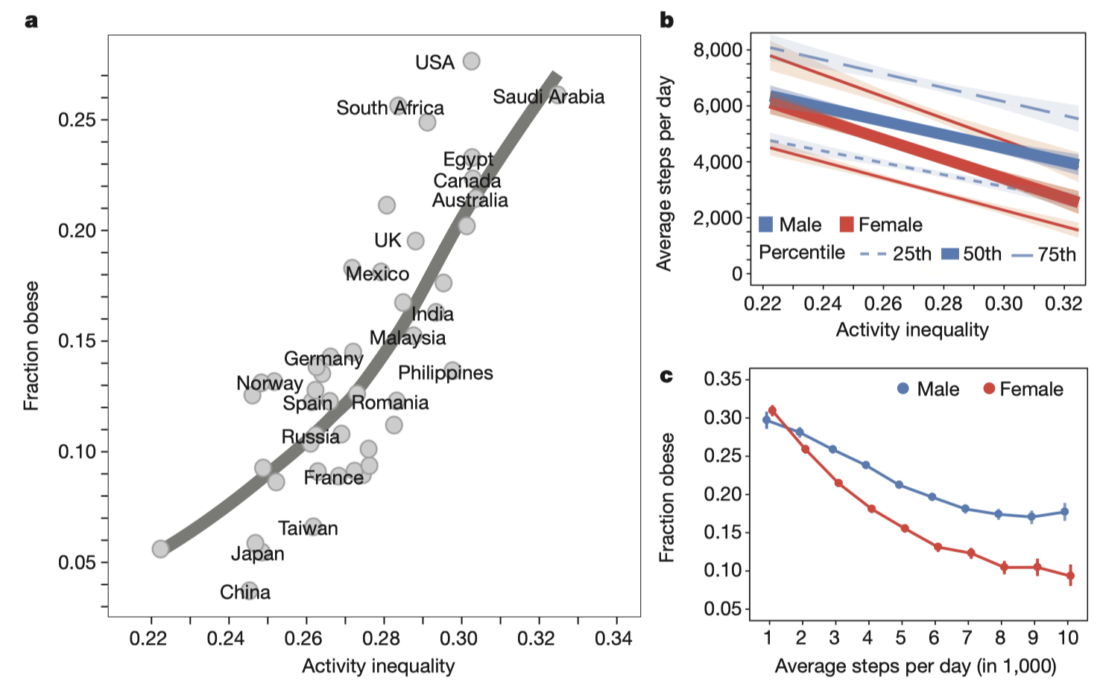
Notes:
Figure 2 | Activity inequality is associated with obesity and increasing gender gaps in activity. a, Activity inequality predicts obesity (LOESS fit; R 2 = 0.64). Individuals in the five countries with highest activity inequality are 196% more likely to be obese than individuals from the five countries with the lowest activity inequality. b, Activity inequality is associated with reduced activity, particularly in females. The figure shows the 25th, 50th, and 75th percentiles of daily steps within each country along with 95% confidence intervals (shaded) as a linear function of activity inequality. As activity inequality increases, median activity (50th percentile) decreases by 39% for males (blue) and by 58% for females (red). c, The obesity–activity relationship differs between males and females and between high- and low-activity individuals. The plot shows the prevalence of obesity as a function of daily number of steps across all subjects in all countries (with 95% confidence intervals). For both males (blue) and females (red), a larger number of steps recorded is associated with lower obesity, but for females, the prevalence of obesity increases more rapidly as step volume decreases (232% obesity increase for females versus 67% increase for males; comparing lowest versus highest activity).

Slide 13
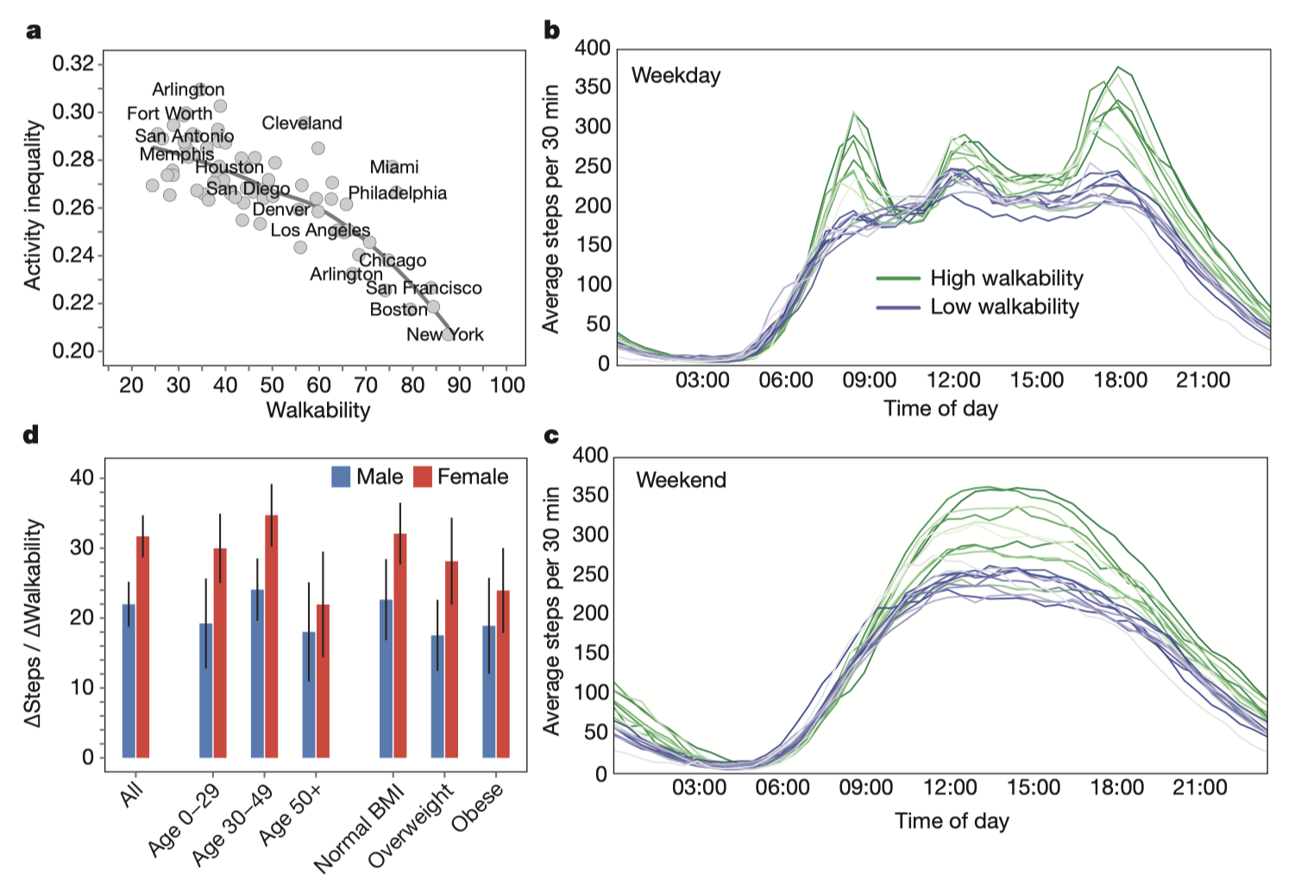
Notes:
Figure 3 | Aspects of the built environment, such as walkability, may mitigate gender differences in activity and overall activity inequality. a, Higher walkability scores are associated with lower activity inequality, based on data from 69 cities in the USA (LOESS fit; R 2 = 0.61).
b, c, Walkability is linked to increased activity levels. Curves show average steps recorded throughout the day in cities in the USA with the top ten walkability scores (green) and bottom ten walkability scores (blue) in our dataset. b, On weekdays, walkable cities exhibit a spike in activity during morning commute (9:00), evening commute (18:00), and lunch times (12:00), while activity is relatively constant and lower overall in less walkable cities. c, On weekend days, people in more walkable cities take more steps throughout the middle of the day, so walkability is associated with higher activity levels even at times when most people are not working or commuting. d, Higher walkability is associated with more daily steps across age, gender and BMI groups. Bars show the steps gained per day for each point increase in walkability score for 24 cities in the USA, including 95% confidence intervals (assuming linear model; Methods). Positive values across all bars reveal that, with increasing walkability, significantly more steps are taken by every subgroup (Student’s t-tests, all P < 10−6 ). The effect is significantly larger for females overall (left; Student’s t-test P < 10−4 ), with the greatest increases for women under 50 years (middle) and individuals with a BMI less than 30 (right).

Slide 14
The Golden Age of APIs: Then and Now
APIs once made massive platform data accessible to researchers
Then: Open endpoints, easy rate limits, little restriction
Twitter:
Era 1:
Firehose: Full access to all public tweets in real time; Only available to a handful of partners or through expensive commercial contracts (e.g., Gnip, now part of Twitter)
Garden Hose: A sampled feed, ~10% of public tweets. Researchers request access
Spritzer: An even smaller sampled stream, around 1%—what most researchers actually got via the free Streaming API
Era 2 (launched in 2021, until Elon takeover in 2023):
Academic Research API v2, free, full-archive access, 10M tweets/month cap
Now:
High barriers (e.g., paid access, deprecated tools)
Legal gray zones (e.g., scraping = violation of TOS)
Platform shutdowns (e.g., Pushshift, Facebook Research)

Slide 15
Twitter API Now
Tier | Monthly Cost | Access Details
Free | $0 | For write-only access You can post 500 posts per month
Basic | $200 | Up to 10,000 tweets read per month. 7-day search history
Pro | $5,000 | Up to 1 million tweets read per month. Search enabled
Enterprise | $42,000+ (rumor) | Full-archive search access
https://docs.x.com/x-api/getting-started/about-x-api

Slide 16
The Golden Age of APIs: Then and Now
APIs once made massive platform data accessible to researchers
Then: Open endpoints, easy rate limits, little restriction
Reddit:
Pushshift: historical and real-time Reddit data access far beyond what Reddit’s own API
Full archives of comments and posts since Reddit’s founding
Queryable JSON file and downloadable dumps (still exists it seems like)
Reddit cut off Pushshift access in 2023
The “PullPush” effort tries to recreate it - we will try it in the lab
Now:
High barriers (e.g., paid access, deprecated tools)
Legal gray zones (e.g., scraping = violation of TOS)
Platform shutdowns (e.g., Pushshift, Facebook Research)

Slide 17
The Golden Age of APIs: Then and Now
APIs once made massive platform data accessible to researchers
Then: Open endpoints, easy rate limits, little restriction
YouTube:
YouTube Data API v3
Originally open and easy to use.
Now requires an API key with quota limits.
Strict use policy and compliance with YouTube’s Terms of Service.
Increased risk of API key revocation for TOS violations
Now:
High barriers (e.g., paid access, deprecated tools)
Legal gray zones (e.g., scraping = violation of TOS)
Platform shutdowns (e.g., Pushshift, Facebook Research)

Slide 18
The Golden Age of APIs: Then and Now
APIs once made massive platform data accessible to researchers
Then: Open endpoints, easy rate limits, little restriction
Facebook:
Graph API (launched 2010)
Allowed programmatic access to posts, likes, friends, group memberships, etc
Huge for early CSS research (e.g., Facebook friendship networks)
Used (and abused) in scandals like Cambridge Analytica
After 2018, Facebook locked down its Graph API
CrowdTangle (with Instagram access) became the semi-official tool, focusing only on public pages and groups (recently deprecated and now blocked for new access)
Now:
High barriers (e.g., paid access, deprecated tools)
Legal gray zones (e.g., scraping = violation of TOS)
Platform shutdowns (e.g., Pushshift, Facebook Research)

Slide 19
Freelon (2018): The post-API age
We used to rely on APIs for social media data. Those days are (mostly) over. Now what?
Heavy dependence on platform APIs is risky: companies can (and do) change access rules overnight.
Teaching platform-specific tools is fragile and short-lived.
We must train students to be adaptable, platform-agnostic, and ethically reflexive.

Slide 20
Freelon (2018): The post-API age
We used to rely on APIs for social media data. Those days are (mostly) over. Now what?
Learn Web Scraping
More flexible than APIs, works on most sites
But: harder to learn, fragile, may violate TOS
Understand TOS and Legal Risks
Do not confuse TOS compliance with basic data privacy and ethics
Violating TOS may result in revoked access, lawsuits, or worse

Slide 21
Freelon (2018): The post-API age
We used to rely on APIs for social media data. Those days are (mostly) over. Now what?
 | APIs | Scraping
Access | Provided by platform | Extracted from public web pages
Limits | Rate-limited, selective data | Depends on HTML structure & your own limit
Reliability | Stable but platform-controlled | Fragile; breaks with site redesign
Legal/Ethical | Often within TOS | Often violates TOS or copyright
Use Case | Ideal for structured, historical data | Better for current or hard-to-access content

Slide 22
Freelon (2018): The post-API age
We used to rely on APIs for social media data. Those days are (mostly) over. Now what?
New skillsets researchers need:
Technical: scraping, automation, browser instrumentation
Legal: understanding TOS, DMCA, GDPR, platform policy
Ethical: balancing public benefit, user rights, and reproducibility
Methodological future:
Less plug-and-play, more hand-crafted, bespoke pipelines
More emphasis on replication packages and ethical transparency

Slide 23
Freelon (2018): The post-API age
We used to rely on APIs for social media data. Those days are (mostly) over. Now what?
Should researchers ever violate TOS to obtain important social data?
How do we balance public interest, user privacy, and corporate control?
What ethical guidelines should we follow when APIs disappear?

Slide 24
Several Methodological Pivots

Slide 25
Platform Auditing: Studying the Black Box
What is auditing?
Systematic evaluation of platforms’ inner workings—what content is recommended, censored, or boosted? Who sees what and why?
Why audit?
Because platforms don’t give us the full picture. APIs are limited. Internal data is off-limits. Platform behavior is opaque by design.
Audit studies often involve data collection methods outside official APIs—scraping, browser instrumentation, or custom logging pipelines are common technical foundations.

Slide 26
Presentation: Haroon et al. (2023)

Slide 27
Platform Auditing: Audit Design as a Genre
Auditing is a genre, not a single method. Sock puppets are one tool, but many others exist.
Examples of audit techniques:
Bots / Sock Puppet
User-side instrumentation (browser extensions, screen recording)
Crowdsourced data donation (especially prevalent in Europe)
Differential exposure experimental tests: Instruct users to do something first (search terms, video watches), then observe algorithmic outputs
Design Challenges:
Keeping everything constant (e.g., geolocation, cookies)
Scaling up without violating terms of service
Minimizing bias from volunteer samples
Notes:
Sock Puppet: Not necessarily a bot; Often a research-grade digital actor used in a controlled experiment; Think of it as a research confederate, but online and sometimes at scale.

Slide 28
The Hunt for Innovative Data
Natural experiments from platform changes
Jaidka, K., Zhou, A., & Lelkes, Y. (2019). Brevity is the soul of Twitter: The constraint affordance and political discussion. Journal of Communication, 69(4), 345–372. https://doi.org/10.1093/joc/jqz023
Guo, Y., Li, Y., & Yang, T. (2023). Civilizing social media: The effect of geolocation on the incivility of news comments. New Media & Society, 14614448231218989. https://doi.org/10.1177/14614448231218989
User-generated data (reviews, images, social features)
Yelp Reviews, LinkedIn Job Posting, Google Images, etc.
Yu, C., & Margolin, D. (2024). Sharing inequalities: Racial discrimination in review acquisition on Airbnb. New Media & Society, 26(3), 1627–1647. https://doi.org/10.1177/14614448221075774
Government or nonprofit data
Open datasets from unexpected places (e.g., real estate, transportation, Google Street View)

Slide 29
Presentation: Park et al. (2023)

Slide 30
User-Centric Behavioral Tracking
What if users are your best data collectors?
Shift focus from platform-provided data to user-contributed data: “If platforms won’t give you the data, work with users who already have it”
Data Donation
Participants manually export and donate their platform activity data (e.g., Facebook “Download Your Data” or Google Takeout)
Screen Tracking
Software logs user interaction in real time (e.g., apps, screenomics)
User-Centric Behavioral Tracking
Usually involves recruiting users to install a new piece of software
Issues/disadvantages?

Slide 31
Presentation: Robertson et al. (2023)

Slide 32
Lab Preview
Web Scraping
Basic
Advanced
YouTube API
Reddit – try out when API goes back online
TikTok API – Apply and hope for the best
Preparing for next week:
Sign up for Face++ API: https://www.faceplusplus.com
Just sign up for the free API; you should not be required to pay
Once signed up, go to https://console.faceplusplus.com/dashboard
Click “Apps” and then click “API Keys”
Sign up for OpenAI (GPT) API: https://openai.com/api/
Go to Dashboard (top-right) and then click “API Keys”
The lab script may cost you $1 to run, but
Jiacheng will share her API with the class
Day 7’s Presentation
Gretchen Corcoran
Paulina Vergara
Jinny Zhang

